Slide 1

Web Final Exam
Ala-too web application

Slide 2
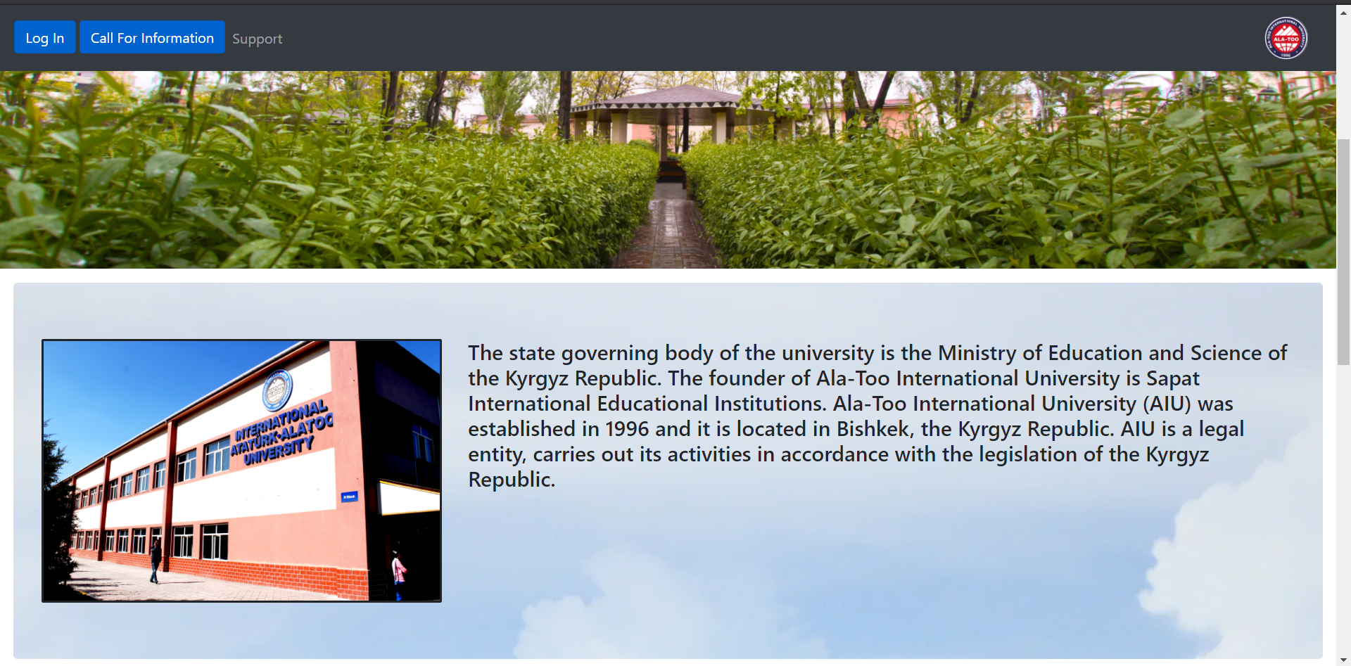
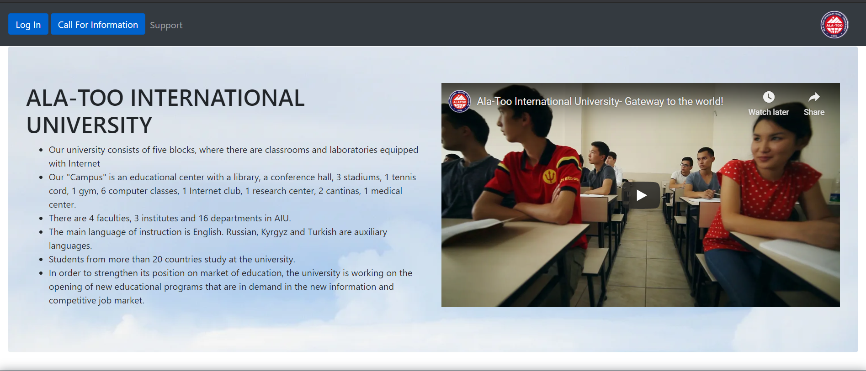
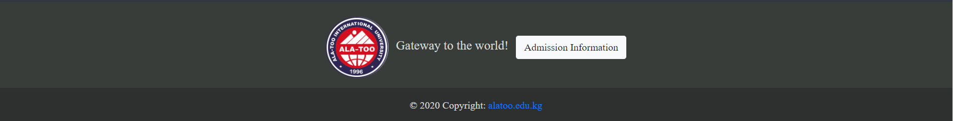
Website Screenshots
This web application is about Ala-Too university.

Slide 3
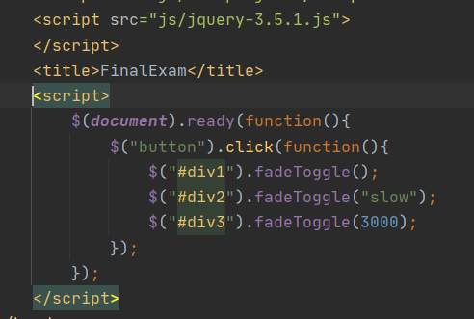
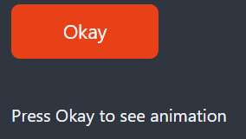
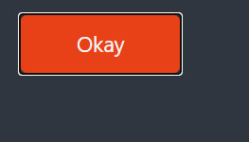
J Query
We have used jquery-3.5.1.js
We have used fading animation
This fades in and out when pressed.

Slide 4
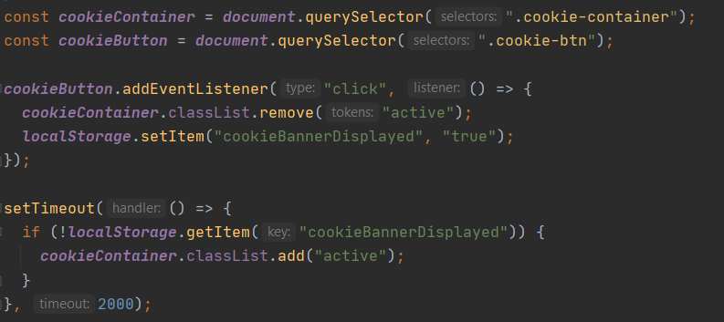
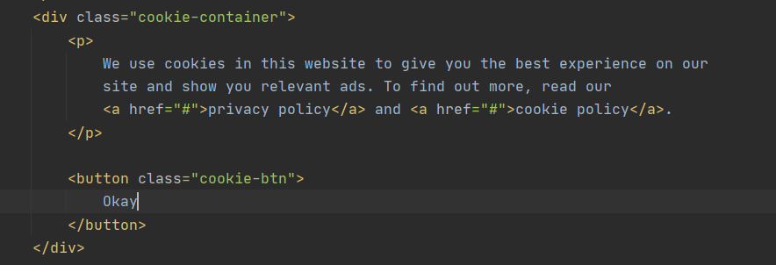
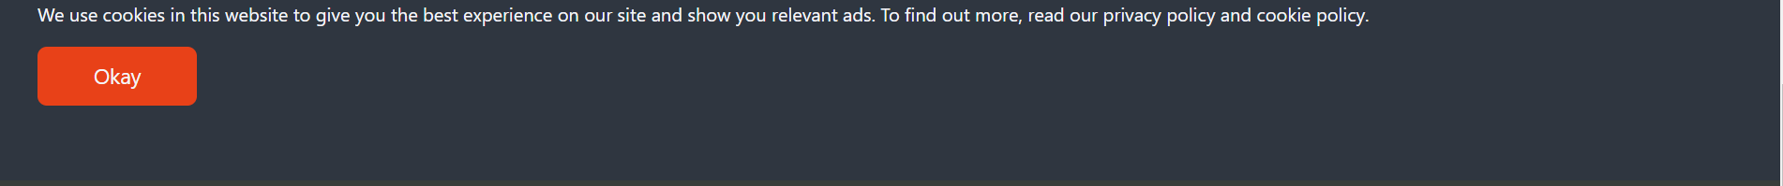
Cookie
Cookie has also been used in our project.

Slide 5
Contributors
Gunduzalp Dogrutekin
Osman Yasir Ozyilmaz

